Slide 1
Docker: A Quick Start Guide
What we will cover
What is a dockerfile and a compose file
How is Gym set up using docker
How to access the GPU with Docker
How is CoastSeg set up Docker
by Sharon Fitzpatrick

Slide 2
Docker Fundamentals & Benefits
Containerization Concept
Development Simplification
GPU Access
Docker packages applications with all dependencies, creating isolated, portable environments that run identically regardless of the host system.
Using Docker gives us a standardized way of accessing the GPU
Eliminates "works on my machine" problems by ensuring consistent environments from development through production.

Slide 3
Installing Docker on Windows
Download Docker Desktop
Visit docker.com and download the Docker Desktop installer for Windows. The installer includes both Docker Engine and Docker Desktop GUI.
Install WSL2
Windows Subsystem for Linux 2 is required for Docker on Windows. Enable WSL2 through PowerShell with administrator privileges using: wsl --install.
Run Installer
Execute the Docker Desktop installer and follow the prompts. Ensure "Use WSL2 instead of Hyper-V" option is selected during installation.
System Reboot
Restart your computer when prompted to complete the installation process and initialize all components properly.

Slide 4
Verifying Your Docker Installation
Run Verification Command
Launch Docker Desktop
Launch PowerShell
Open Docker Desktop from your Start Menu. This automatically starts the Docker engine in the background.
docker info

Slide 5
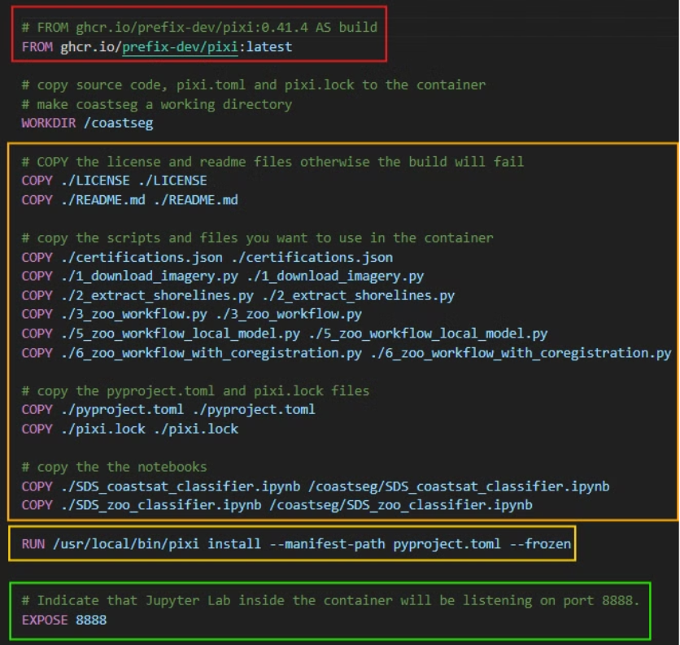
What is a Dockerfile?
Instructions to build a container image, defining its base, dependencies, and runtime behavior
Base Image & Build Context: Begins with a base image (using the FROM instruction) that sets the foundation for your container.
Layered Instructions: Uses commands (like RUN, COPY, ADD) to build image layers, which enable caching and incremental builds.
Runtime Configuration: Defines how the container behaves at startup through CMD or ENTRYPOINT, and configures environment variables, working directories, and metadata.
Networking & Storage: Optionally exposes ports and specifies volumes for networking and persistent data.

Slide 6
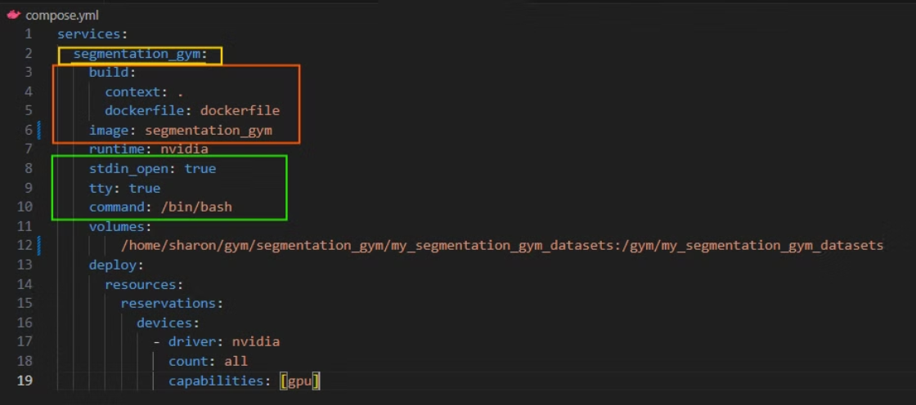
What is a Docker Compose File?
YAML configuration that sets up the environment, dependencies, and runtime settings for a Dockerized application
YAML Configuration: Defines services, networks, and volumes in a declarative format.
Service: A defined container configuration that runs a specific application.
Network: A virtual bridge that connects containers for communication.
Simplified Commands: Build, start, and stop all services with a single command.
Name of the service is segmentation gym
How to build service from the image segmentation gym
Allow the container to run in an interactive shell

Slide 7
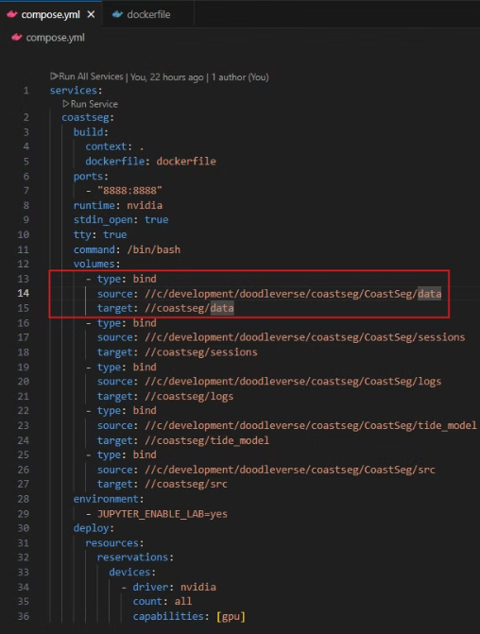
Bind Mounts
⭐ Bind Mounts essentially link your local folder to your container's folder
⭐ Any changes made to a bind mount folder are reflected in the folder locally
Direct Host-Container Link: A bind mount directly maps a file or directory from your host system to a specific location inside the container.
Real-Time Synchronization: Changes made in the bind-mounted directory on the host are immediately reflected in the container, and vice versa.
Runtime Configuration: Bind mounts are set up when the container is started (via Docker Compose or the Docker CLI), not during the image build process.
Here my folder "//c/development/doodleverse/coastseg/CoastSeg/data" is linked to my containers "CoastSeg/data"

Slide 8
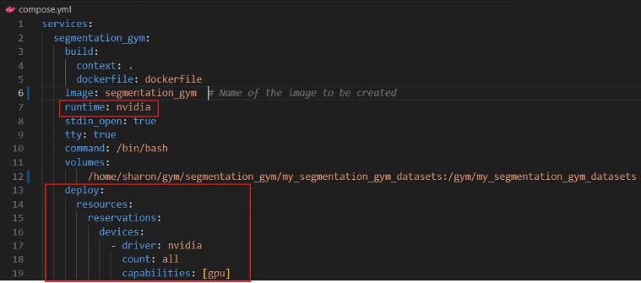
GPU Access with Compose File
Compose Configuration: Specify GPU requirements in the Compose file using deploy resources (e.g., setting device capabilities).
Runtime Option: Use the appropriate runtime flag (such as runtime: nvidia or --gpus) to enable GPU support.
⚠️ This will NOT work if your computer does not have NVIDIA drivers and the NVIDIA Container Toolkit installed (QR code for guide)
This allows your computer's nvidia GPU during the containers runtime

Slide 9
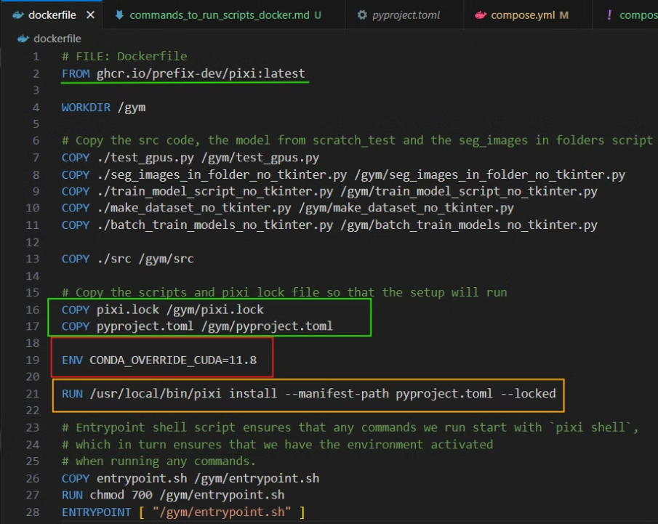
Gym Dockerfile
Base Image: Pixi
Use the base docker image provided by Pixi
🚫 DO NOT COPY the .pixi folder
its massive
it may cause your environment to solve incorrectly
Set the CUDA version
This tells Pixi what version of CUDA will be available at RUNTIME
⚠️ You will get build errors about missing cuda libraries if you don't put this here
Install the Pixi Environment
Install the Pixi environment defined in the pyproject.toml + pixi.lock file we copied over

Slide 10
How to Get Your Cuda Version
NVCC --version
(base) sharon@Sharonator:~$ nvcc --version
nvcc: NVIDIA (R) Cuda compiler driver
Copyright (c) 2005-2021 NVIDIA Corporation
Built on Thu_Nov_18_09:45:30_PST_2021
Cuda compilation tools, release 11.5, V11.5.119
Build cuda_11.5.r11.5/compiler.30672275_0

Slide 11
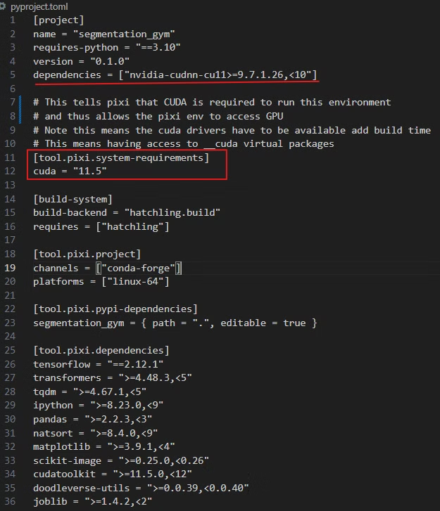
Gym Pyproject.toml
[tool.pixi.system-requirements]
[tool.pixi.system-requirements]
cuda = "11.5"
This tells pixi that the environment needs to be installed so that it can access CUDA
[project]
dependencies = ["nvidia-cudnn-cu11>=9.7.1.26,<10"]
Notice that I am using nvidia-cudnn-cu11 instead of nvidia-cudnn-cu12
Your nvidia-cudnn MUST match the CUDA version defined in system requirements

Slide 12
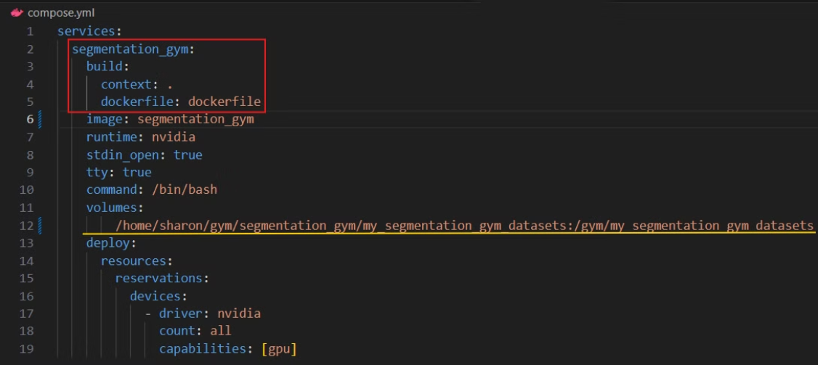
Gym Compose File
Use the gym dockerfile
Tells compose to use the dockerfile in the current folder (context .) and call this service segmentation_gym
Bind Mount
Here we mount my local segmentation gym dataset to my container's segmentation gym dataset folder
We use the <SOURCE>:<DEST> format

Slide 13
Gym Docker Container GPU Access Issues
Docker does NOT have access to all the libdevice libraries since the compose file only gives the container access to the GPU at runtime NOT build time
This means that you will need to run your model training and inference in eager mode
tf.config.run_functions_eagerly(True)
If you want to access libdevice libraries you would need use a Nvidia image with a GPU as the base image
If you don't run the models in eager mode you will get the error below because these files are NOT in the container
packages/tensorflow/python/eager/execute.py", line 52, in quick_execute
tensors = pywrap_tfe.TFE_Py_Execute(ctx._handle, device_name, op_name,
tensorflow.python.framework.errors_impl.InternalError: libdevice not found at ./libdevice.10.bc [Op:__inference__update_step_xla_5925]

Slide 14
CoastSeg Files
Essential Docker Files
Essential Pixi Files
Navigate to the CoastSeg repository or website to download these critical configuration files:
Download these supporting files to ensure proper environment configuration:
Dockerfile - Contains instructions for building the CoastSeg image
pixi.lock - Locks dependency versions for reproducibility
compose.yml - Defines services, networks, and volumes
pyproject.toml - Defines Python package specifications
These files provide the blueprint for creating your containerized CoastSeg environment and handling dependencies automatically.
These files ensure consistent package versions and proper Python environment configuration within your container.

Slide 15
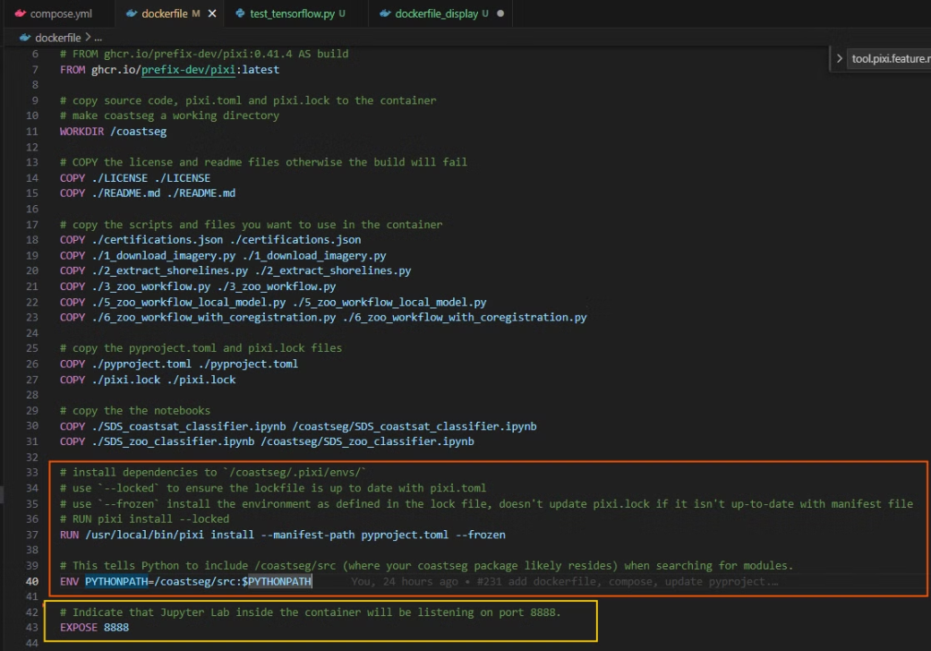
CoastSeg DockerFile
Pixi Setup
Install the exact versions of the dependencies listed in the pixi.lock file
Jupyter Lab Setup
Expose the container's port 8888 so we can connect to the jupyter lab instance will run on that port on our host machine

Slide 16
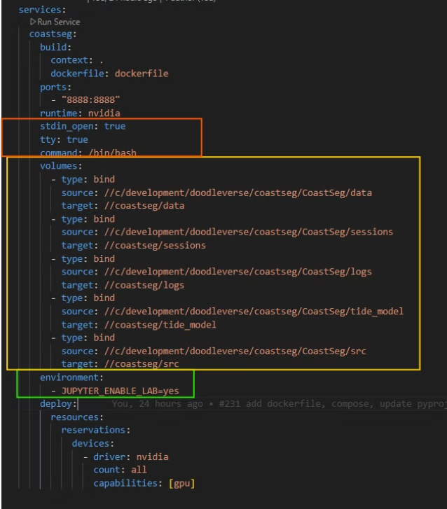
CoastSeg Compose File
Allow the container to be run in an interactive shell
Mount the folders data, sessions, logs and the coastseg source code from my computer into the container
Enable JUPYTER LAB to run

Slide 17
Build & Run the Container
Step 1
Step 2
Step 3
Step 4
docker compose up -d --build
docker ps
docker exec -it <CONTAINER ID>
pixi shell --frozen
Lists all the running docker containers
--frozen: install the environment as defined in the lockfile. Without checking the status of the lockfile.
-d : mean build the container in deatached mode
-it creates an interactive terminal session, allowing you to run commands directly inside the container as if you were working in a normal shell environment.
--build: means build the docker container if it does not exist
--locked: only install if the pixi.lock is up-to-date with the pixi.toml1. Conflicts with --frozen.

Slide 18
Building the CoastSeg Container
Build the Container
PS C:\development\doodleverse\coastseg\CoastSeg> docker compose up -d --build
Docker PS
PS C:\development\doodleverse\coastseg\CoastSeg> docker ps
CONTAINER ID IMAGE COMMAND CREATED STATUS PORTS NAMES
d0ce32be11f6 coastseg-coastseg "/bin/bash" About a minute ago Up About a minute
0.0.0.0:8888->8888/tcp coastseg-coastseg-1
Launch the Docker Container in Interactive Mode
PS C:\development\doodleverse\coastseg\CoastSeg> docker exec -it d0ce32be11f6 /bin/bash

Slide 19
Running Jupyter Notebook in Docker
CoastSat workflow
> pixi shell --frozen
(coastseg) > jupyter lab SDS_coastsat_classifier.ipynb --ip=0.0.0.0 --allow-root --no-browser
Zoo Workflow
> pixi shell -e ml --frozen
(coastseg:ml) > pixi run run_notebook

Slide 20
Core Docker Commands
Command
Description
docker ps
List only running containers.
docker ps -a
List all containers (both running and stopped).
docker stop
Stop one or more running containers (use container ID or name).
docker images
List all Docker images stored locally.
docker rm
Remove one or more containers (use container ID or name).
docker info
Display system-wide information about Docker, including configuration and usage.

Slide 21
Wrap Up
Dockerfiles let you configure how to build your image
Docker compose files let you define how to build your image
I have more guides available at https://2320sharon.github.io/reproducible_environments_guide/

