Slide 1
Using Pixi: A Quick Start Guide
An introduction to Pixi. This guide will help you understand how Pixi can be used and what makes it special
by Sharon Fitzpatrick

Slide 2
What is Pixi?
Pixi is a package management tool
🧪 Conda: Leverage the existing conda ecosystem to obtain packages written in Python, C, C++, and many other languages.
🔄 Reproducibility: Work in dedicated, isolated environments that can be easily recreated.
🛠️ Tasks: Manage complex pipelines effortlessly.
🌐 Multi Platform: Ensure compatibility across Linux, macOS, Windows, and more.
🧩 Multi Environment: Compose multiple environments within a single Pixi manifest.
🏗️ Building: Build packages from source using powerful build backends.
📦 Distributing: Distribute your software via conda channels or various other options.
🐍 Python: Full support for pyproject.toml and PyPI dependencies.
🌍 Global Tools: Install globally available tools, safely stored in separate environments.

Slide 3
Key Features of Pixi
🔑 Reliable Environment
⭐Pixi Environments can mix conda-forge and pypi dependencies
⚡ Super Fast Dependency Solver
Pixi will create your environment the same way every time. Pixi uses a lock file to lock in all your dependencies, so they install the same every time
Unlike Conda, mamba, and pip solvers Pixi can solve your dependencies SUPER fast.

Slide 4
Wait so… what exactly is Pixi?
Pixi is what we wanted conda to be.
Pixi environments can use a mix of conda-forge and pip dependencies natively
Pixi lets you specify EXACTLY what packages should be install from conda and from PyPi
Pixi LOCKs the EXACT version of each dependency for each OS
❌ No more hoping the environment will solve correctly

Slide 5
Core Pixi Components
This is what makes up a Pixi workspace
🔑 Pixi.lock
📂 pyproject.toml
📦 .pixi
lock-file that describes the exact dependencies
file that describes the workspace
folder that contains the environment
🔑 Pixi still uses conda and pip packages to create your environment

Slide 6
Install Pixi with Powershell
Open Powershell
Execute Installation Command
powershell -ExecutionPolicy ByPass -c "irm -useb https://pixi.sh/install.ps1 | iex"
Verify Installation
If you got an error don't worry we address this in the next slide
pixi --version

Slide 7
Give Pixi Access to Powershell
Option #1: Give Pixi Permission to Run
Set-ExecutionPolicy RemoteSigned -Scope CurrentUser
Option #2: Temporarily Give Pixi permission to run
this command is temporary so you will need to re-run it each time you run pixi shell in a new powershell window
function Invoke-Pixi {
powershell.exe -ExecutionPolicy Bypass -Command "pixi $args"
}
Set-Alias pixi Invoke-Pixi -Option AllScope

Slide 8
Pixi Demo
We will be using Pixi on a new code base to understand how to use its core features
1. Add conda depdencies
2. Add pip depdencies
3. Activate a pixi environment
4. Use Multiple Environments

Slide 9
1. Create the Pixi environment
For this demo we will start by creating a folder called pixi demo and creating our pyproject.toml file with the following command
Windows PowerShell PS C:\development\7_demos> mkdir pixi_demo PS C:\development\7_demos> cd .\pixi_demo\ PS C:\development\7_demos\pixi_demo> pixi init --format pyproject Created C:\development\7_demos\pixi_demo\pyproject.toml PS C:\development\7_demos\pixi_demo> ls Directory: C:\development\7_demos\pixi_demo Mode LastWriteTime Length Name ---- ------------- ------ ---- d----- 3/27/2025 1:42 PM src -a---- 3/27/2025 1:42 PM 122 .gitattributes -a---- 3/27/2025 1:42 PM 38 .gitignore -a---- 3/27/2025 1:42 PM 403 pyproject.toml
Initialize the project
pixi init —format pyproject
This creates a pyproject.toml file and a pixi.lock file that will hold the pixi configuration information

Slide 10
2. Add conda-forge dependencies
powershell
Add a conda forge dependency
> pixi add mkdocs
Added mkdocs >=1.6.1,<2
>
pixi add mkdocs
Adds mkdocs as a conda forge dependency
Updates the dependencies pyproject file list in the pyproject.toml file

Slide 11
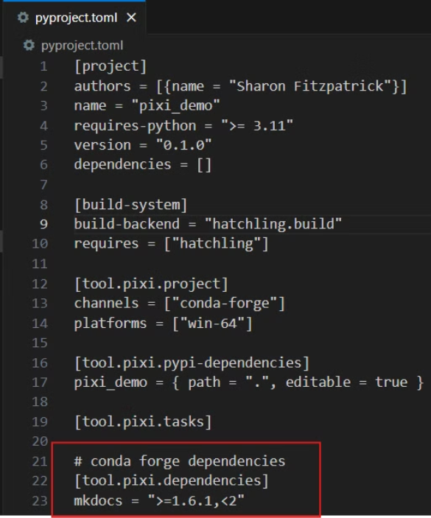
2. Add conda-forge dependencies
Pyproject.toml
Pyproject.toml
After running pixi add mkdocs this updates the tool.pixi.dependencies to include mkdocs
You could have specified a version by running pixi add mkdocs<1.6.2

Slide 12
3. Add pypi dependencies
Add a pypi dependency
powershell
pixi add pandas --pypi
PS C:\development\7_demos\pixi_demo> pixi add pandas --pypi
Added pandas >=2.2.3, <3
Added these as pypi-dependencies.
PS C:\development\7_demos\pixi_demo>
-- pypi: adds pandas a pypi depdency
Updates the dependencies pyproject file list in the pyproject.toml file

Slide 13
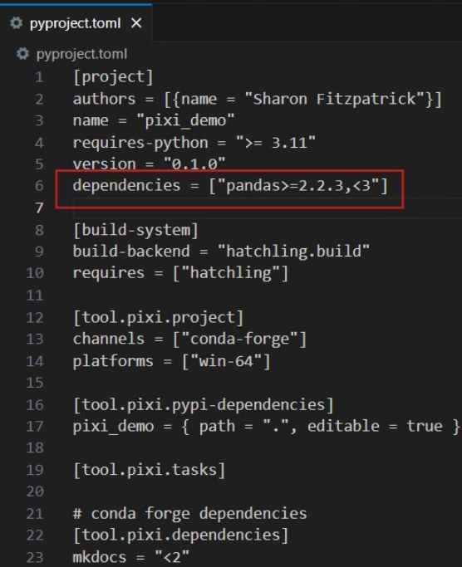
3. Add PyPi dependencies
Pyproject.toml
Pyproject.toml
pixi add pandas --pypi
Updated [project] section to add pandas to the dependencies list
dependencies: contains all the dependencies from pip

Slide 14
4. Install and Activate the Environment
Install the Environment
powershell
This installs the environment from the pixi.lock file
> pixi install
The default environment has been installed.
> pixi shell
(pixi_demo) >
> pixi install
The default environment has been installed.
Activate the Environment
⭐ Notice that (pixi demo) is the name of the environment matches the name of the name in the pyproject.toml file
This activates the default environment we made
equivalent to conda activate <ENVIRONMENT NAME>
> pixi shell

Slide 15
5. Test Pixi Environment
❗ Unlike conda, Pixi environments are specific to the folder they are created in.
> pixi shell
(pixi_demo) > python
>>> import pandas
>>> import mkdocs
>>> quit()
Pixi Shell
Now that pixi shell is active we can use the environment just like we would with conda.
Exit the Shell
Here we open python and we can use the two dependencies we installed and both work!
To exit pixi shell enter exit
(pixi_demo) > exit
>
After you exit the (pixi_demo) is gone

Slide 16
6. Create Multiple Environments
🌟 Pixi allows you to create multiple environment within the same pixi file
List all your Pixi Environments
Under [tool.pixi.environments] lists all the environments including the original environment (default) we made earlier
Optional Dependencies
[project.optional-dependencies]
geo = ["geopandas"]
[tool.pixi.environments]
default = {features = [], solve-group = "default"}
geo = {features = ["geo"], solve-group = "default"} # geo environment with geopandas dependency
geo is the name of the environment and ["geopandas"] is a list of the dependencies for that environment
Solve group tells Pixi to make the environment compatible with the environment listed in the solve-group.
Example: solve-group = "default" for the test environment means that the "geo" environment will be compatible with the default environment

Slide 17
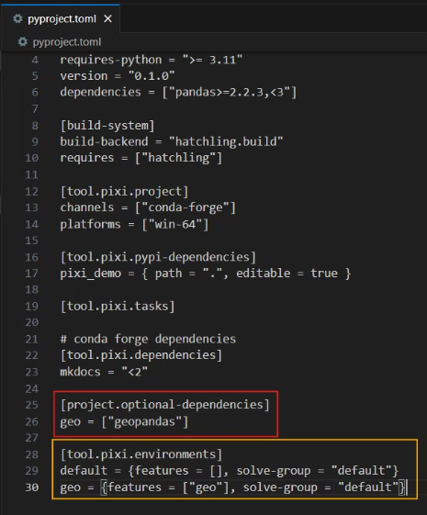
Pyproject.toml after multi environment
Optional Dependencies
pyproject.toml
Lists the two new environments we added
Tool.pixi.environments
Lists all environments
Indicates that all environments should be compatible with our default environment
Geo Environment
[project.optional-dependencies]
geo = ["geopandas"]
[tool.pixi.environments]
geo = {features = ["geo"], solve-group = "default"}
Default Environment
[project]
authors = [{name = "Sharon Fitzpatrick"}]
name = "pixi_demo"
requires-python = ">= 3.11"
version = "0.1.0"
dependencies = ["pandas>=2.2.3,<3"]
# conda forge dependencies
[tool.pixi.dependencies]
mkdocs = "<2"

Slide 18
7. Using Multiple Environments
Install New Environment
> pixi install -e geo
The geo environment has been installed.
> pixi shell -e geo
(pixi_demo:geo) > python -c "import geopandas"
(pixi_demo:geo) > exit
> pixi shell
(pixi_demo) >
-e : this means install the environment
pixi install -e geo
Using the New Environment
pixi shell -e geo
Switch Environments
To exit the geo environment and use the default environment
🍧 Whenever you run pixi shell pixi will automatically call pixi install behind the scenes
exit
pixi shell

Slide 19
CoastSeg Demo with Pixi
In this demo we will show how to set up CoastSeg with Pixi
Install the CoastSeg default environment
Launch a notebook
Switch Environments to the "ml" environment
Launch the zoo notebook in the ml environment
Full tutorial on using CoastSeg with Pixi

Slide 20
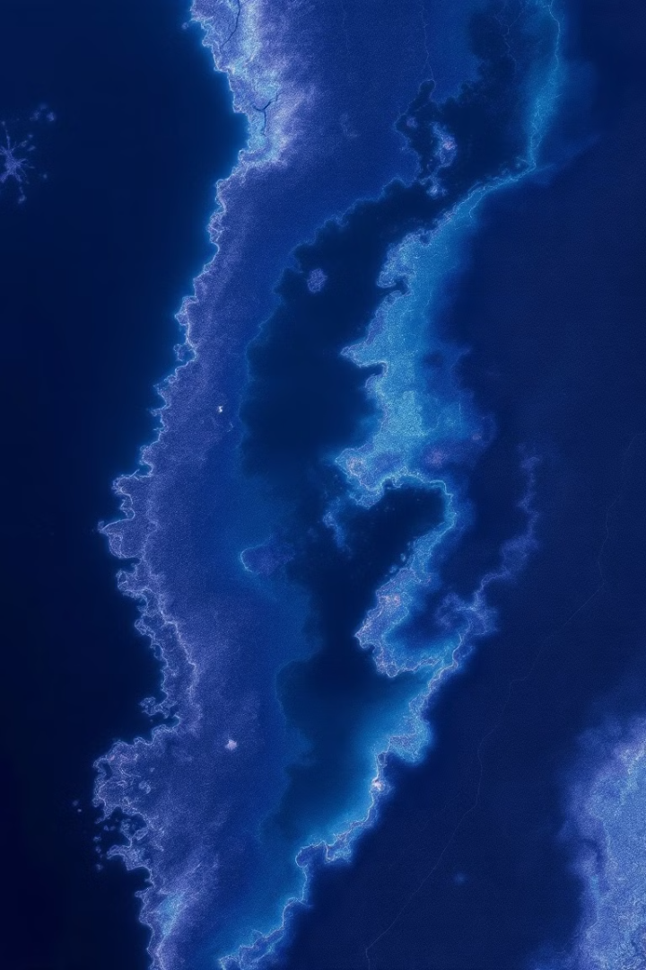
Install CoastSeg with Pixi
Open Terminal
Change directories to CoastSeg
cd <COASTSEG LOCATION>
Run Installation Command
Installs the default environment
--frozen : means install the environment exactly as it is defined in the pixi.lock
pixi install --frozen
Activate the default environment
pixi shell --frozen

Slide 21
Troubleshooting Pixi Errors
tells powershell that Pixi is safe to connect to Powershell
function Invoke-Pixi {
powershell.exe -ExecutionPolicy Bypass -Command "pixi $args"
}
Set-Alias pixi Invoke-Pixi -Option AllScope
pixi shell --frozen

Slide 22
Launch Jupyter Notebook
Verify the installation worked
Terminal
python -c "import coastseg"
C:/CoastSeg > pixi install --frozen
C:/CoastSeg > pixi shell --frozen
(coastseg) C:/CoastSeg >
(coastseg) C:/CoastSeg > python -c "import coastseg"
(coastseg) C:/CoastSeg >
(coastseg) C:/CoastSeg > jupyter lab SDS_coastsat_classifier.ipynb
Launch the notebook
jupyter lab SDS_coastsat_classifier.ipynb

Slide 23
Switch to ML environment
⭐ Normally tensorflow and transformers are NOT compatible with the rest of the coastseg dependencies but by putting them in their own environment we can use them
Switch Environments
Terminal
👆 Remember Pixi Shell will automatically run pixi install if the environment has not been installed
C:/CoastSeg > pixi install --frozen
C:/CoastSeg > pixi shell --frozen
(coastseg) C:/CoastSeg >
(coastseg) C:/CoastSeg > python -c "import coastseg"
(coastseg) C:/CoastSeg >
(coastseg) C:/CoastSeg > jupyter lab SDS_coastsat_classifier.ipynb
pixi shell -e ml --frozen
Import ML dependencies in new environment
python -c "import tensorflow; from transformers import TFSegformerForSemanticSegmentation;"

Slide 24
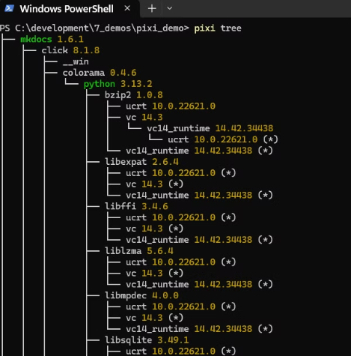
Bonus Troubleshooting Tips
#1: Delete the .pixi file to clear existing environment
This removes all the installed packages
Run pixi install after removing to re-install all packages
If things are really bad
1. Delete pixi.lock
2. Delete .pixi
3. Run pixi install
#2: View the dependencies of your packages
pixi tree -i <PACKAGE NAME>
pixi tree

Slide 25
Bonus Troubleshooting Tips
#3: Use --frozen instead of --locked
If your lock file is not up to date with your workspace use — frozen to use the dependencies installed in the .pixi folder

Slide 26
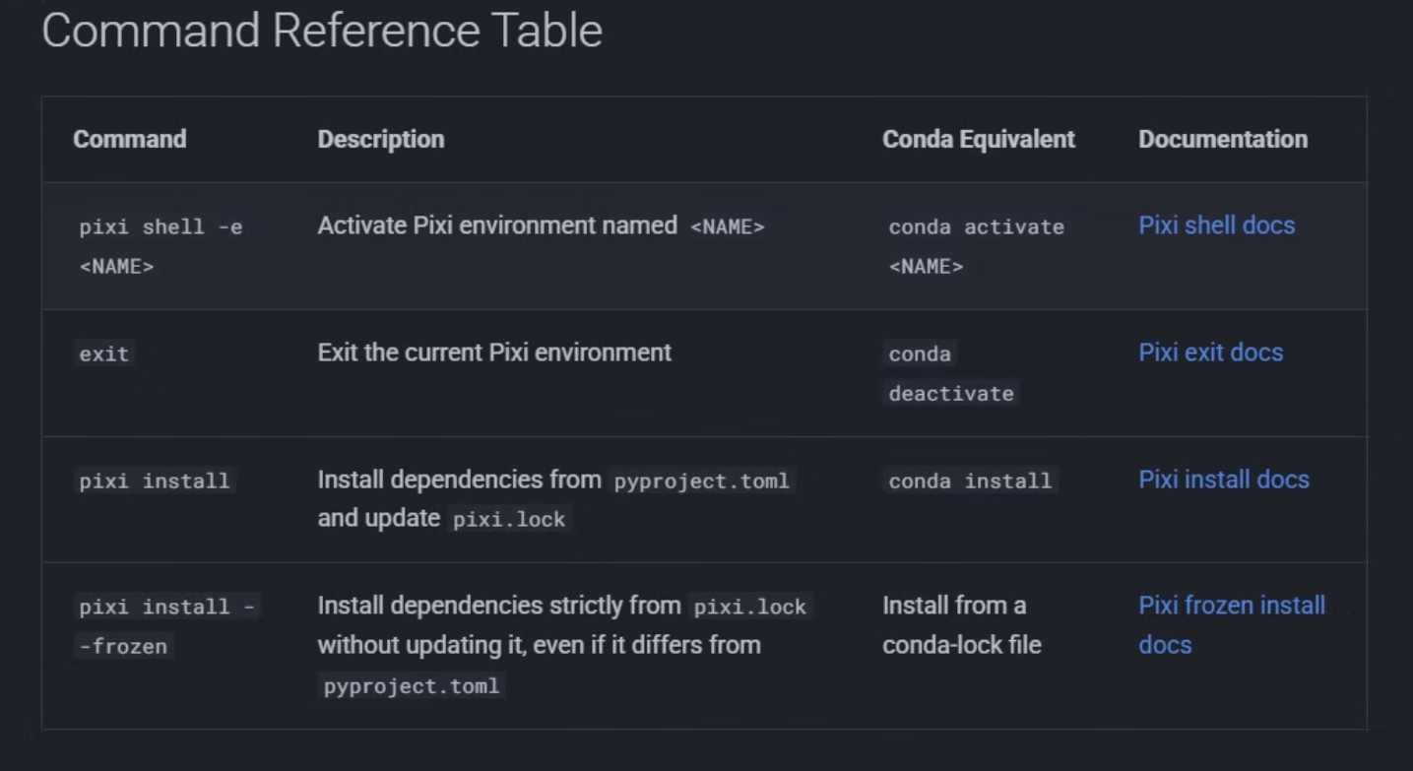
Pixi Command Reference Table

